Slide 1

Project Title -Network Port Scanner
Student Name: K Abhi Ram Reddy
AICTE ID : STU682435072d25a1747203335
College Name: Pallavi Engineering College

Slide 2

PROBLEM STATEMENT
Network administrators and security professionals need a reliable, user-friendly way to identify active services and potential vulnerabilities on their networks.
Without clear visibility into open ports, systems remain exposed to unauthorised access, rogue services, and misconfigurations, making it difficult to maintain a secure infrastructure.

Slide 3
Project Description
This project is a Network Port Scanner featuring a Graphical User Interface (GUI) designed to scan target IP addresses for open ports and active services.
It allows users to specify an IP address and a port range (such as the well-known ports 1-1024) to map network exposure quickly.
For example, during recent testing against target 10.70.51.10, the tool successfully identified open ports like Port 53 (DNS), providing immediate value for service enumeration and security auditing.

Slide 4

WHO ARE THE END USERS?
Network Administrators: For mapping local networks and verifying expected services.
Cybersecurity Analysts & Penetration Testers: For identifying vulnerabilities and rogue services during security audits.
IT Support Specialists: For troubleshooting network connectivity and firewall issues.

Slide 5

Technology Used
Programming Language: Python
Network Scanning Backend: Nmap / python-nmap library
Frontend/GUI: Tkinter, PyQt, or similar Python GUI framework (based on the repository structure)

Slide 6
RESULTS
The scanner successfully probes targeted IP addresses and returns the status of designated ports. As demonstrated in the scan report, querying target 10.70.51.10 over ports 1-1024 accurately detected an open DNS service on Port 53.

Slide 7
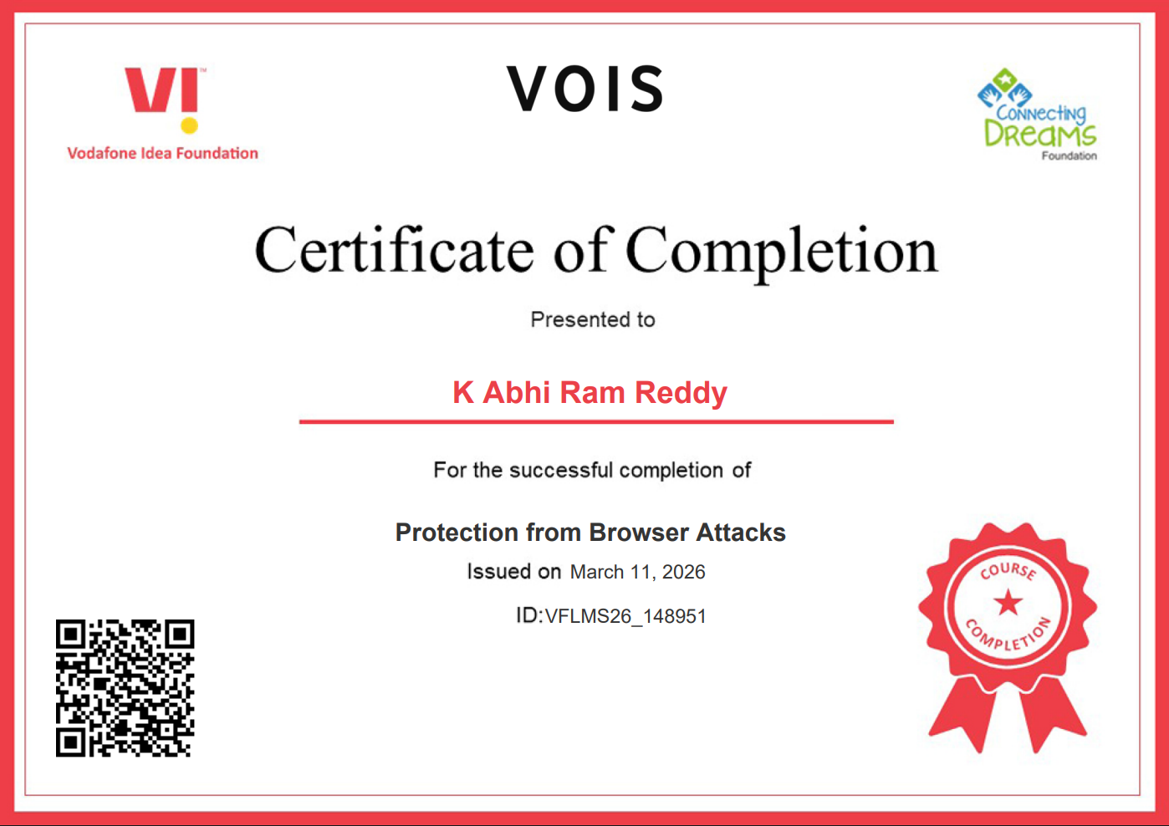
Certificate - Protection from browser attacks

Slide 8

Certificate - Introduction to System Security

Slide 9
GitHub link
https://github.com/00abhiram/Network-Port-Scanner/tree/main

Slide 10
Thank you
.
.

